Slide 1
Distribution of Covid-19 vaccine in WA State and king county
The supply of vaccine will be limited at first and distribution will be prioritized
FindYourPhaseWA.org
Anticipated locations to get vaccine
Cost will not be a barrier to get the vaccine
Vaccine safety is a priority

Slide 2
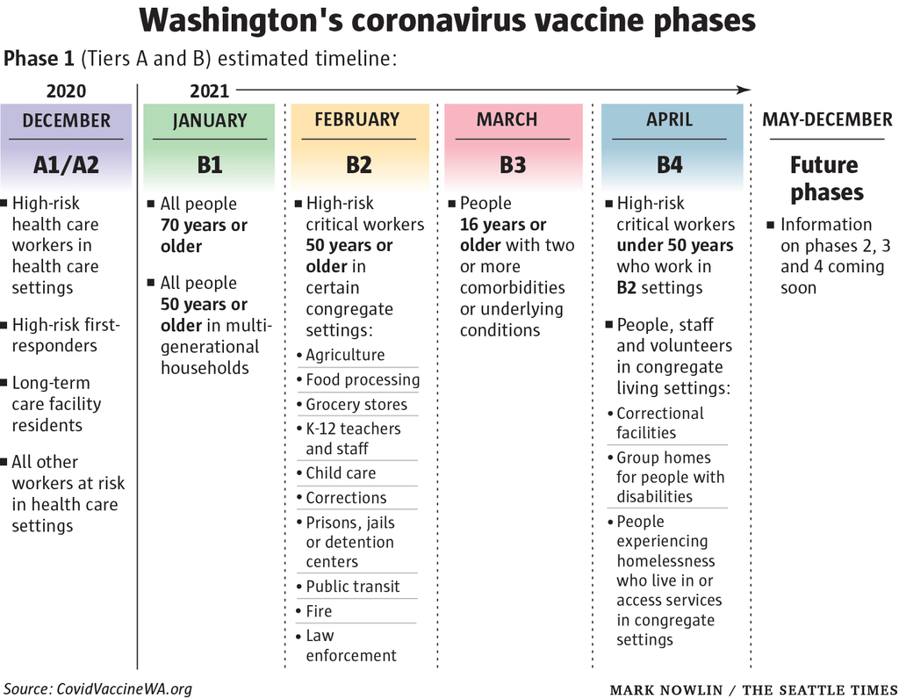

Slide 3
How Will covid-19 vaccine impact schools?
Teachers and school staff are prioritized in Phase B2 (over age 50) and B4
Vaccines may play a role in negotiations between SPS and teachers union for return to in-person learning
Clinical trials are just beginning for children and it is unknown if Covid-19 vaccine will be a part of the required vaccines for school in the future
Seattle Public Schools is working with partner organizations to potentially provide vaccine clinics to school staff and then the community, similar to our flu clinics this fall

Slide 4
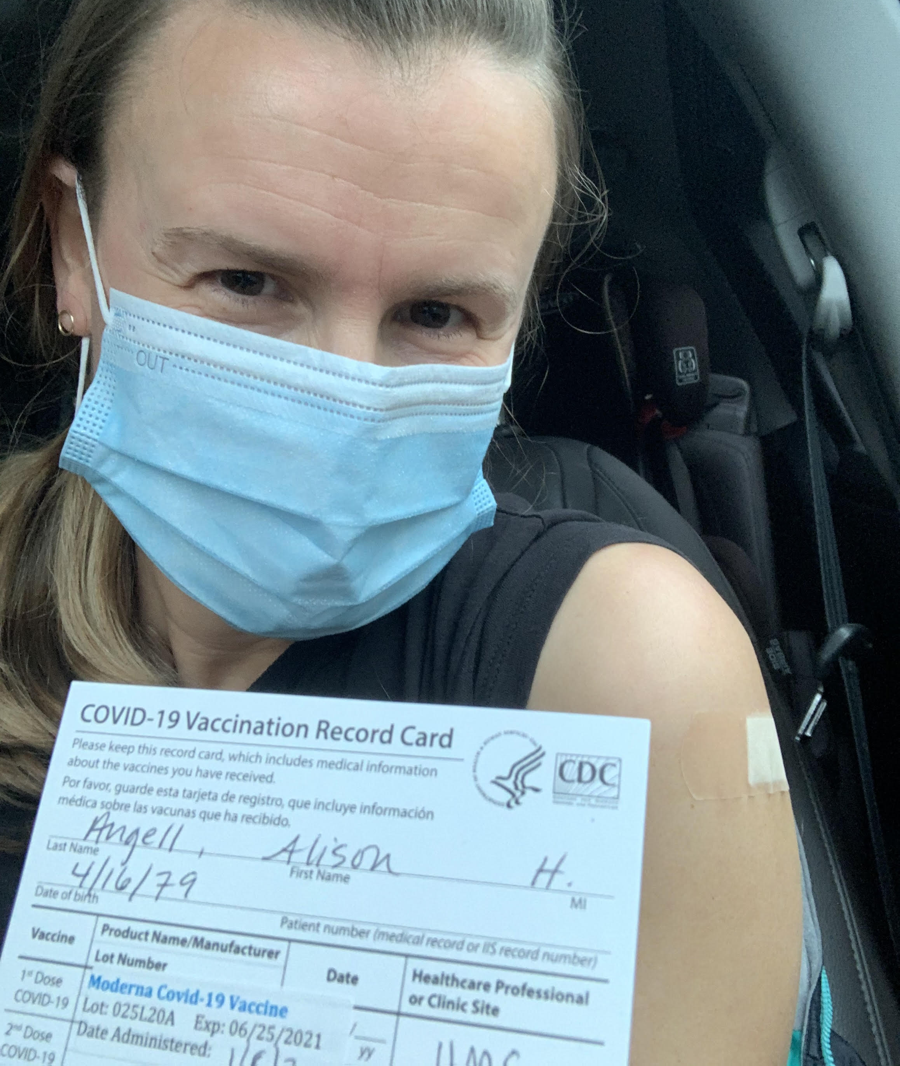
First Alki Staff member to receive covid-19 vaccine- NURSE ANGELL!

Slide 5
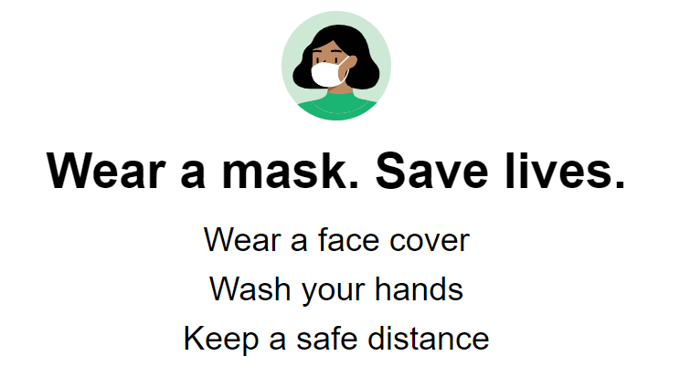
Will the vaccine end the pandemic?
A safe and effective vaccine against COVID-19 will be a major breakthrough in preventing COVID-19 infections and is a reason to be hopeful! The vaccine alone won't end the pandemic right away.

Slide 6
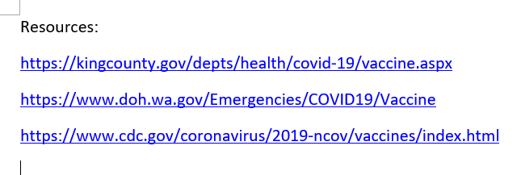
Please be aware of the following Covid testing resources:
Public Health SCAN program Use the code SCANKIDS as a quick way to bypass the daily limits for testing.
Free COVID testing Includes West Seattle Walk-Up testing site.
Email Alki Nurse Alison Angell with questions ahangell@seattleschools.org

